Slide 1
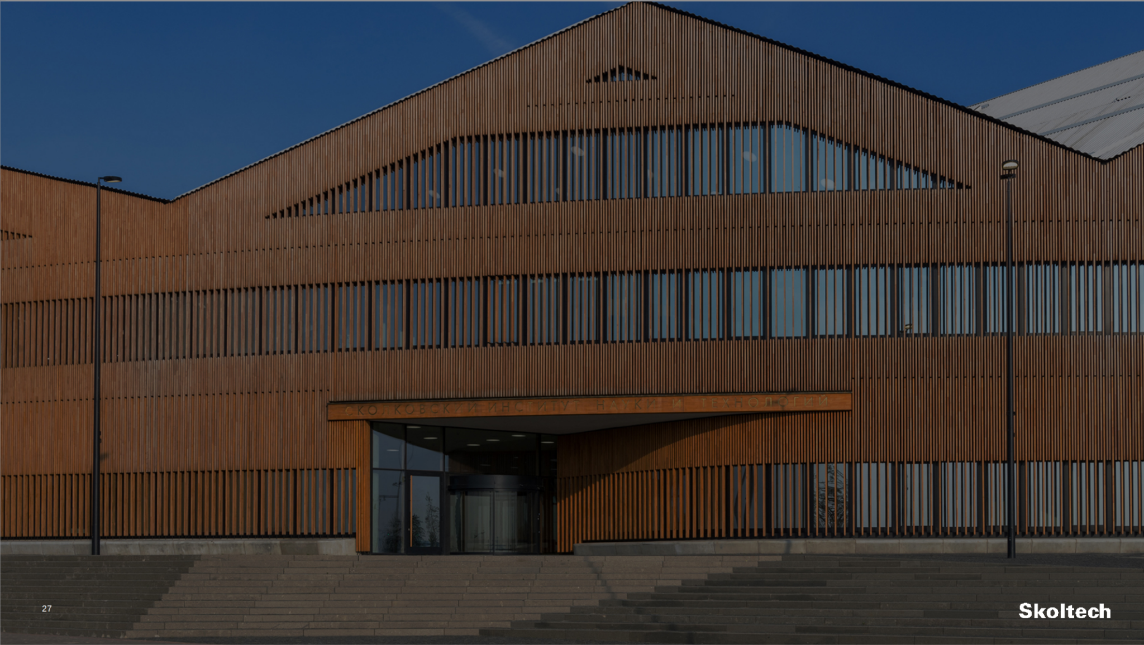
Final Project
AI IMU ++
Based on article:
AI-IMU Dead-Reckoning
Martin Rossard, Axel Barrau and Silvere Bonnabel
Student: Max Alymov
Xuan Nguyen
Instructor: Gonzalo Ferrer

Slide 2
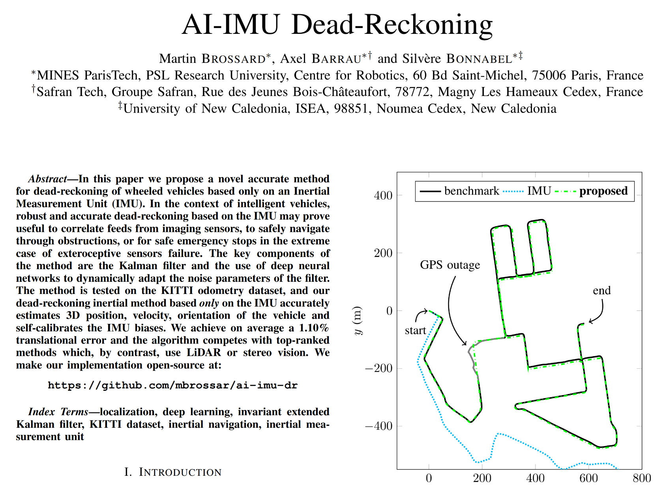
Paper Overview
Self-calibrates IMU
Invariant EKF
Pseudo Measurement
CNN Covariance Estimator
1.1 % translation error on KITTI
Notes:
So in this project, we take the paper from brossard AI IMU dead reckoning as references, which was published 5 years ago.
The challenge is to accurately determine a vehicle's position using only an IMU, which is a sensor that measures rotation and acceleration. Traditional methods struggle because IMU data can be noisy and accumulates error. So it was the main problem to solve here, positioning with only IMU, without others additional sensor like camera, gps, Lidar.
Basically this paper about using neuron network to estimate covariance value for kalman filter, and it can provide very good result 1.1% of translation error.
And this result can be used as pre process for SLAM, or it can perform reliable positioning when other sensors fail (e.g., tunnels with no GPS.
For more detail, in the paper they proposed to use Invariant Kalman filter with pseudo measurements to improve the filters performances.

Slide 3
What and Why Invariant Extended Kalman Filter
Kalman filters working on Lie groups
Preservation of Geometric Symmetries
Improved Robustness and Convergence
Independent Error Dynamics
Overall, it's better !!
Notes:
This is Kalman filter, working in Lie group, which allow us
to preserve the geometric symmetries properties of the state of system’s dynamics
improve robustness and convergence
It was anwer from chat gpt, now let break it down step by step:

Slide 4
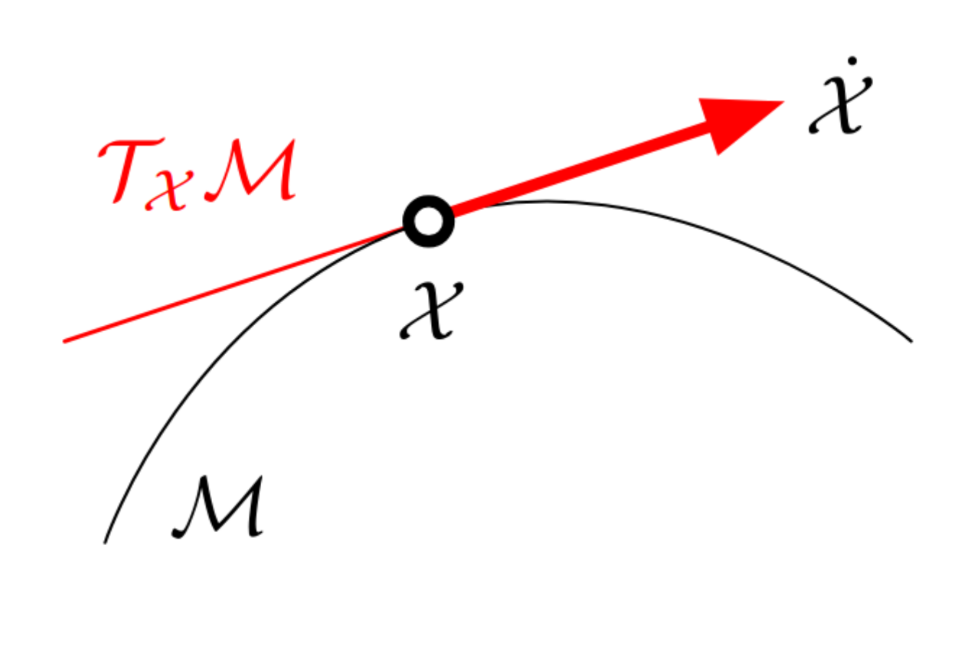

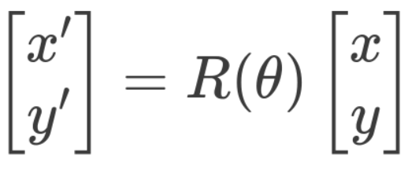
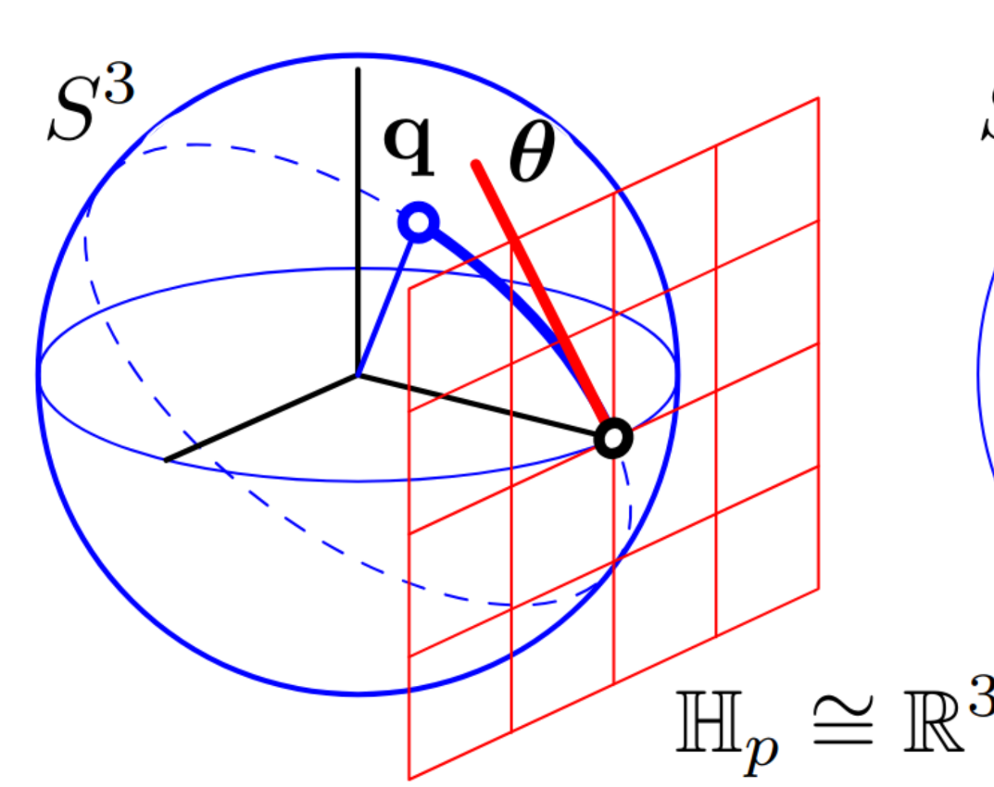

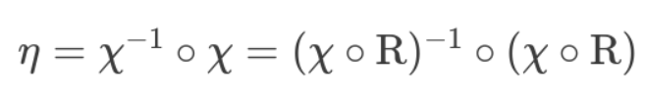
Lie group and Preserve geometric symmetries properties
So, example about this symmetries, what will be preserved, independent from trajectory. Not the geometrical symmetry
Weird Space
Vector Space
Invariant under Rotation
Notes:
A Lie group is a mathematical frame work that satisfies certain axioms. For example this curve, if we set the constraint is distance to some point equal constant, we have a circle. Similarly in 3D we have a sphere like this. One more additional requirement is this surface should be continuous and smooth ( (no pick, jumping)) then we call it Lie group
There exist a mapping function (1 to 1) between Vector space and some point on the surface, which call Exponential map that we learned in the course.
click
There's a mapping function that takes vectors from a vector space and converts them into transformations between points on the surface
About preservation: Rotational invariance: Translational invariance:Scaling invariance:
Symmetries Preserved

Slide 5
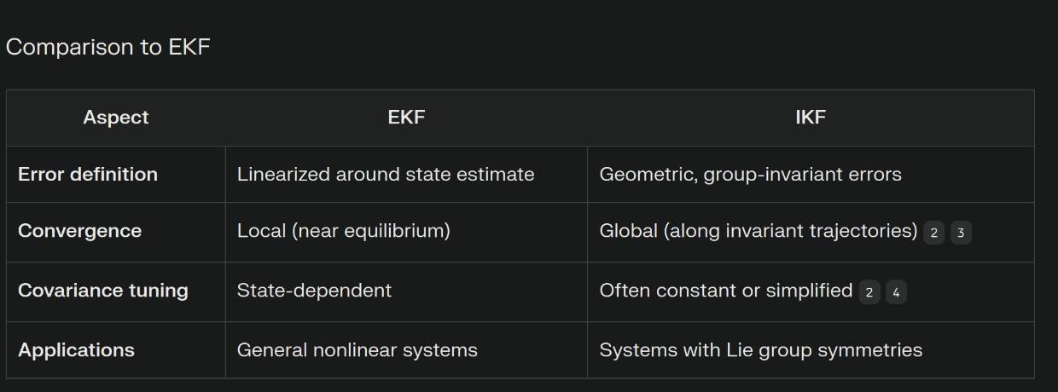
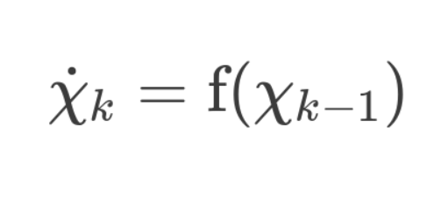

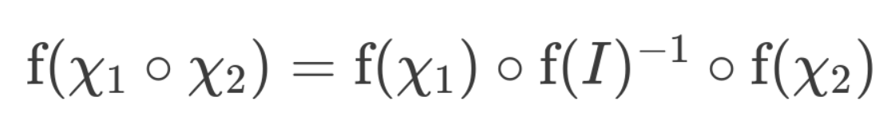
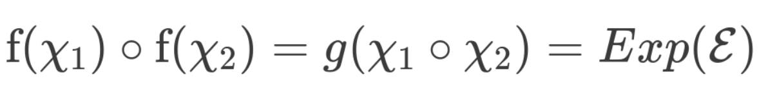
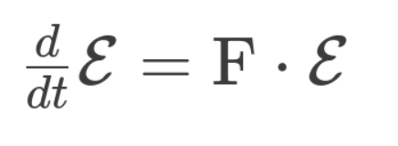
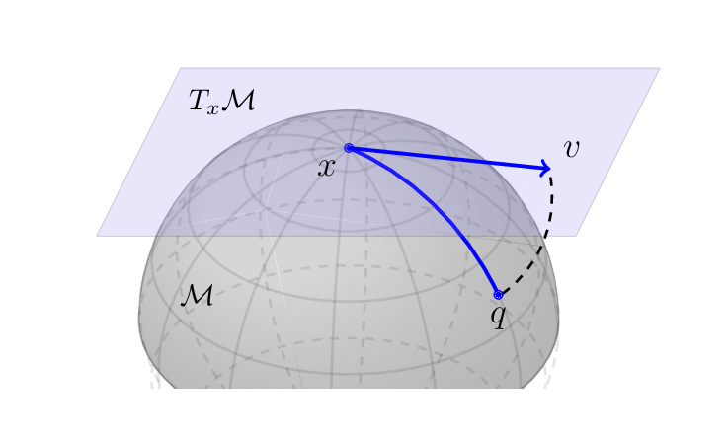
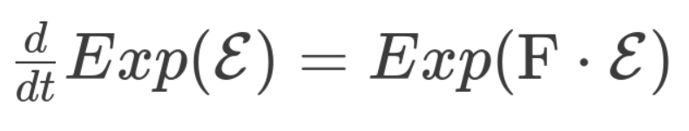
Check Error Independence
So for the movement in 3D space, we only have the translation and rotation. If we can express the state in term of LIe group, we can convert the nonlinear function into linear error through LIe group. And these errors doesnt depend on the state it self
Affine Group Theory
Vector Space
Lie Weird Space
Linear propagation
Independent KF State
Constant Jacobian
Global Convergence
Kinematic/Dynamic System
Log-Linear Error Theory
linear propagation of dynamic error, without higher order term
Notes:
So Lie group is a big picture, inside that it has a sub group, that can be useful for us. it comes from the Affine Group theory, let images we can write the kinematics or dynamics equation of the system as a function f. Now if this f function satisfies this properties, and the epsilon here is difference between chi1 and chi2 inside Lie group.
We can write this error as linear function in vector space, this result is realy important, because the matrix F here, which was essentially covariance matrix doesnt depend on the previous estimated state.
The filter’s error dynamics remain consistent under transformations like rotations, translations, or scalings. Which mean the jacobian matrix, doesnt depends on the previous estimated state. Hence we dont need to worry our wrong estimated state will negatively affect the filter
To obtain this, we need to find the choice of class coordinates systems, we get the error propagation is linear first order function
If we dont do this, we get the Jacobian depends on the state -> more wrong the state -> more wrong covariance -> more wrong estimation

Slide 6

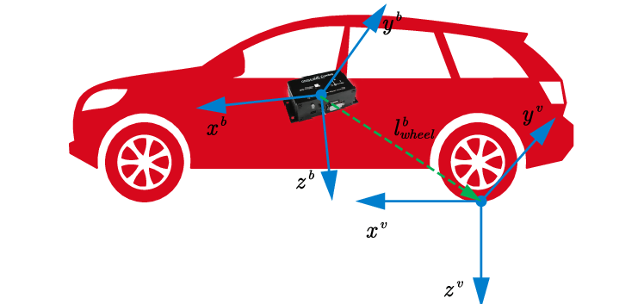
Problem Formulation
Integrate IMU data -> position
Notes:
From IMU we can integrate acceleration triple time and find the position of the car, but it was harmful because of noise biases, misalignment . now we need to find the way to model it
we introduce a state-space model for wheeled vehicles, between the choice for reference frame, as a recommendation that keep the frame with highest order of differentiation as reference frame.

Slide 7
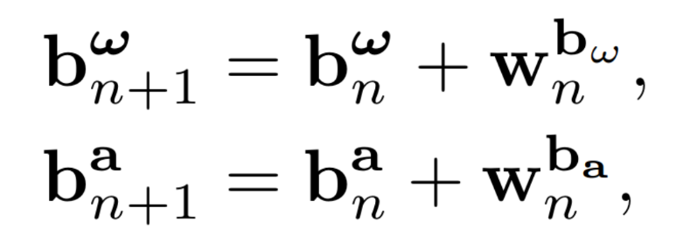
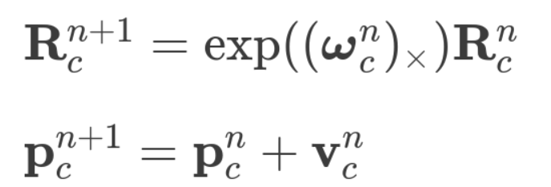
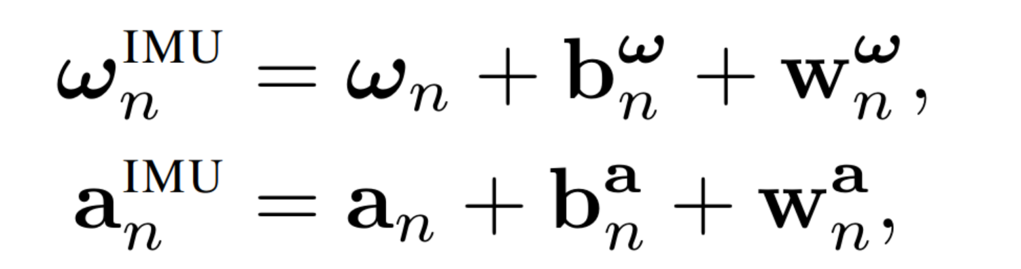
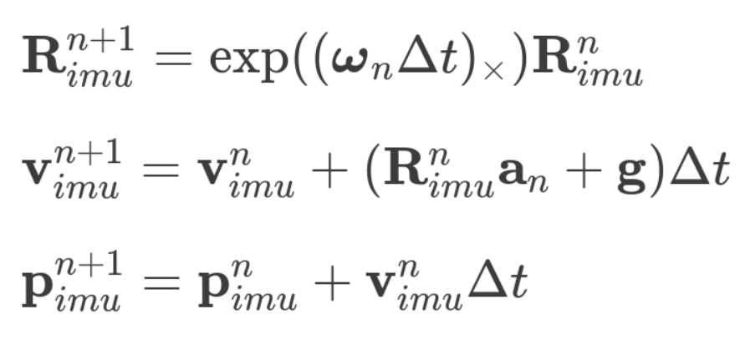

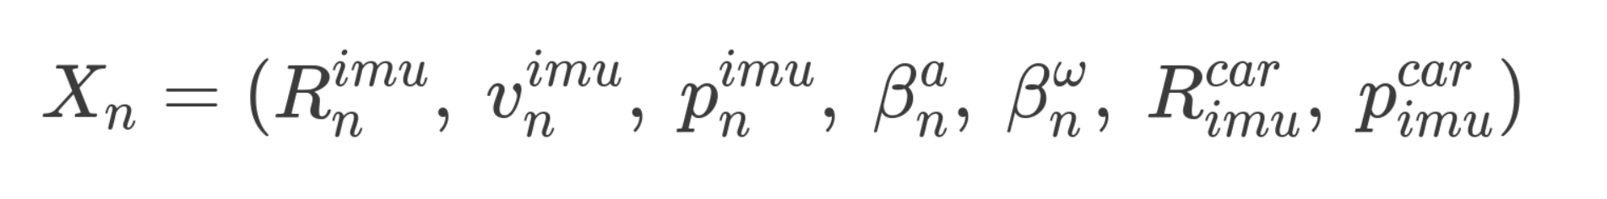

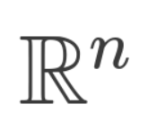
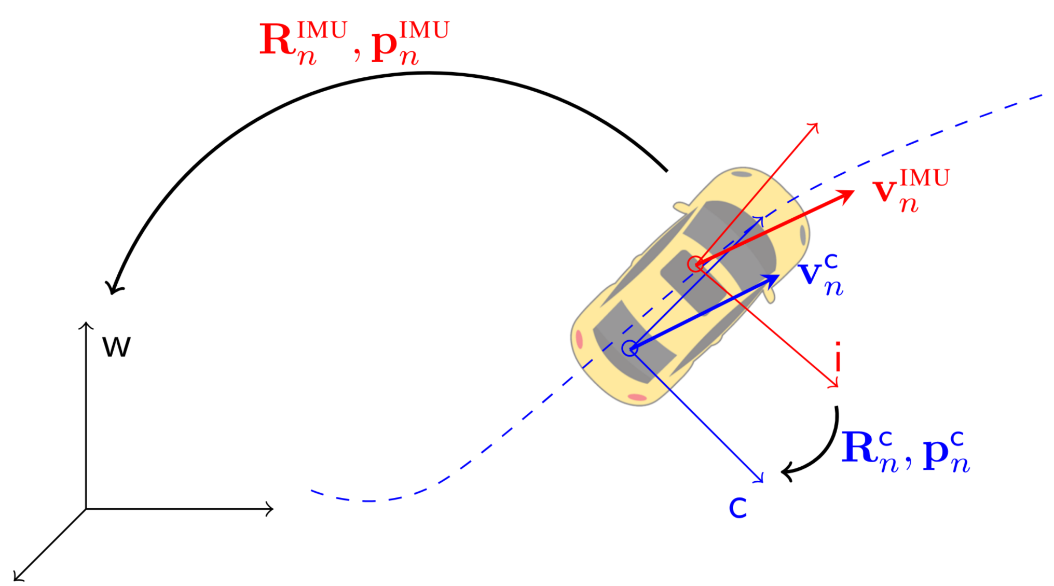
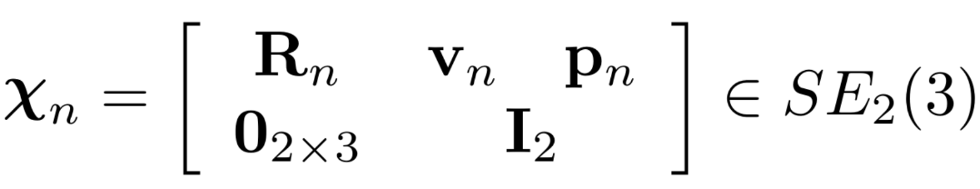
IMU Modelling - Propagation
SO(3)
IMU/Global
Bias
Car/IMU
Affine Group Theory
Extension of Lie group SE(3)
Notes:
So, the idea here is to mix the Lie element State and vector state into kalman filter
But when we go to check the the condition of Affine group (if this affine group theory is satisfied, we have a beautiful dynamic error model, and Jacobian matrix is not depends on the Previous estimation). But the problem is that is was not satisfied, hence we need to introduce a new LIE group (extension of the Lie group SE(3))

Slide 8
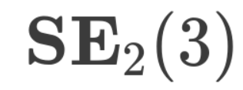
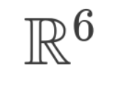
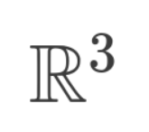
IMU Modelling - Propagation
SO(3)
IMU/Global
Bias
Car/IMU
Affine Group Theory
SO(3)
Notes:
So, the idea here is combine vector space and Lie space into

Slide 9
IMU Modelling - Propagation
SO(3)
IMU/Global
Bias
Car/IMU
Affine Group Theory
SO(3)
Notes:
Now, after transform the IMU state into

Slide 10
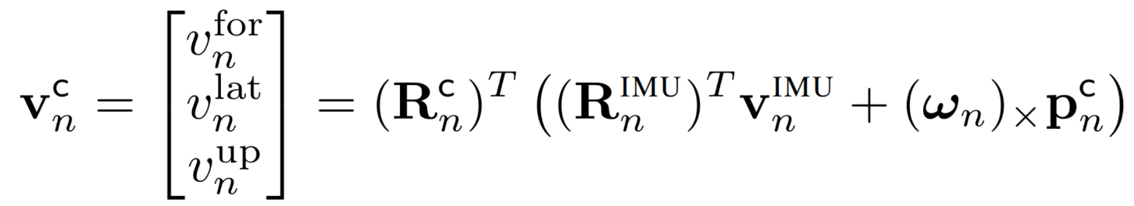
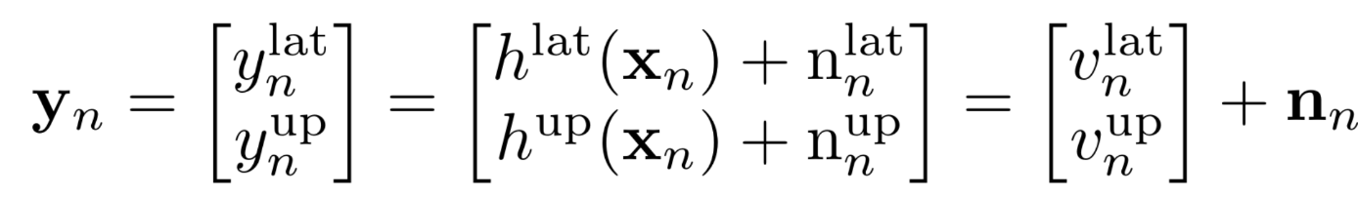
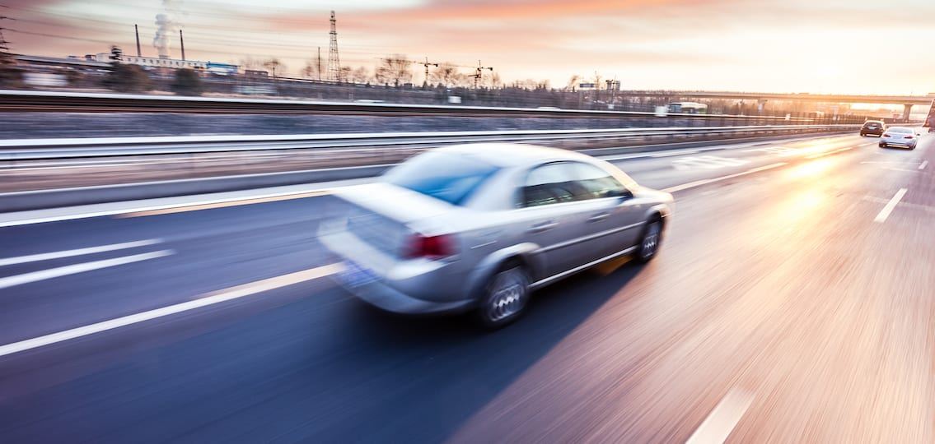
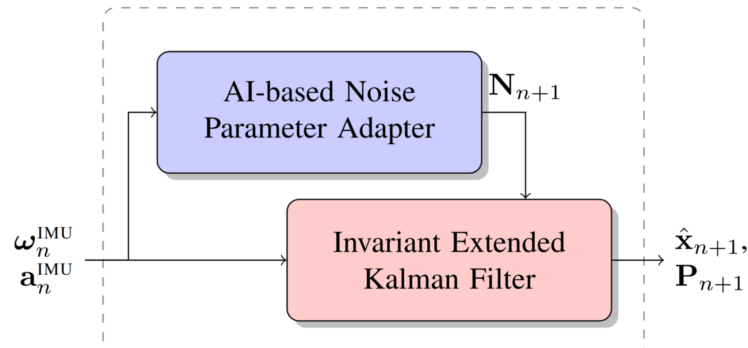
IMU Modelling - Pseudo Measurement
Measurement Model
Noise (N)
Notes:
We take the side information about the movement of car, we know that in car frame, the car can only move forward, without moving on lateral y direction and vertical direction Hence we have the constraints is these 2 velocities should be equal to zero. But to align this equation into Kalman filter framework, we loose the constraints, not exactly zeros but zeros + some noise

Slide 11
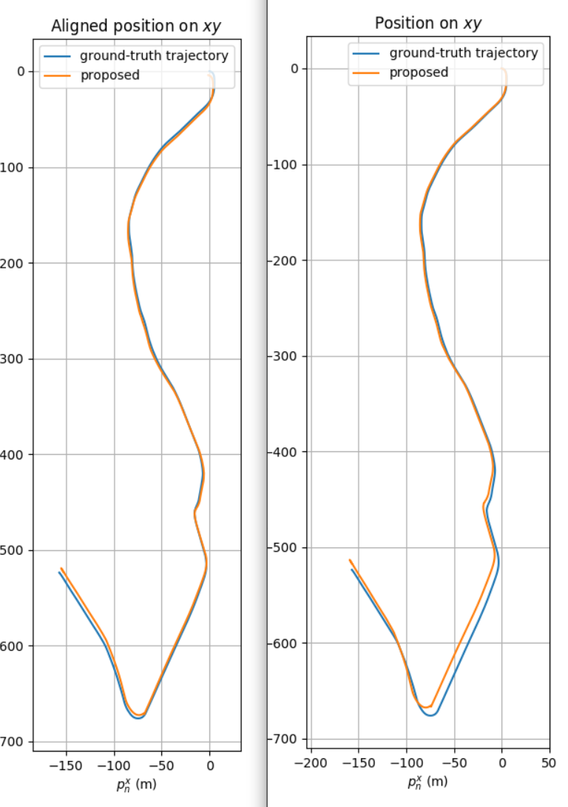
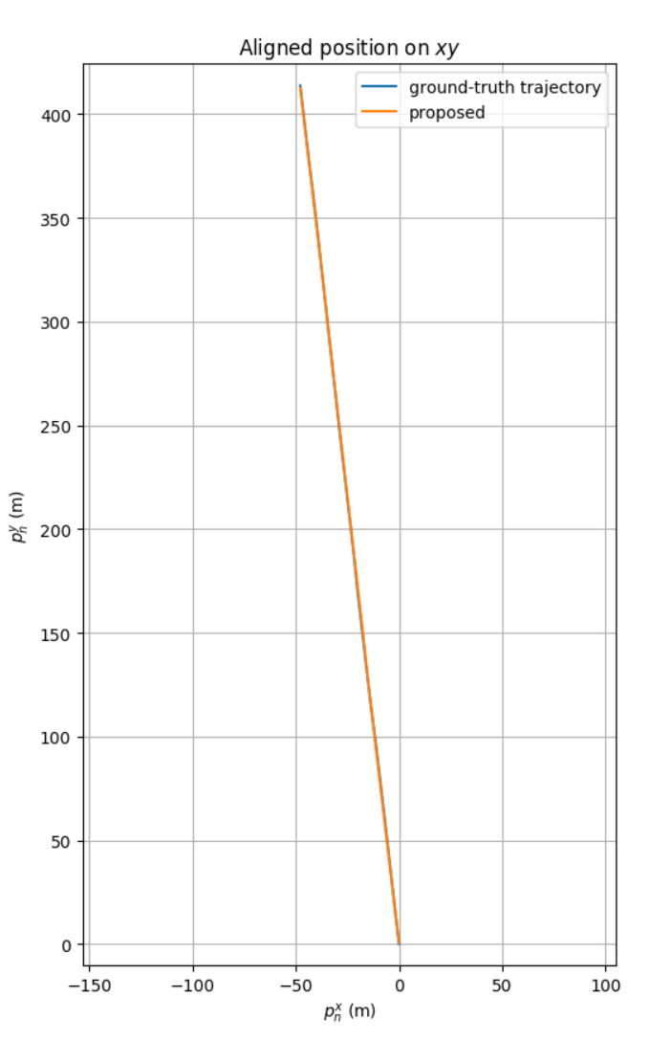
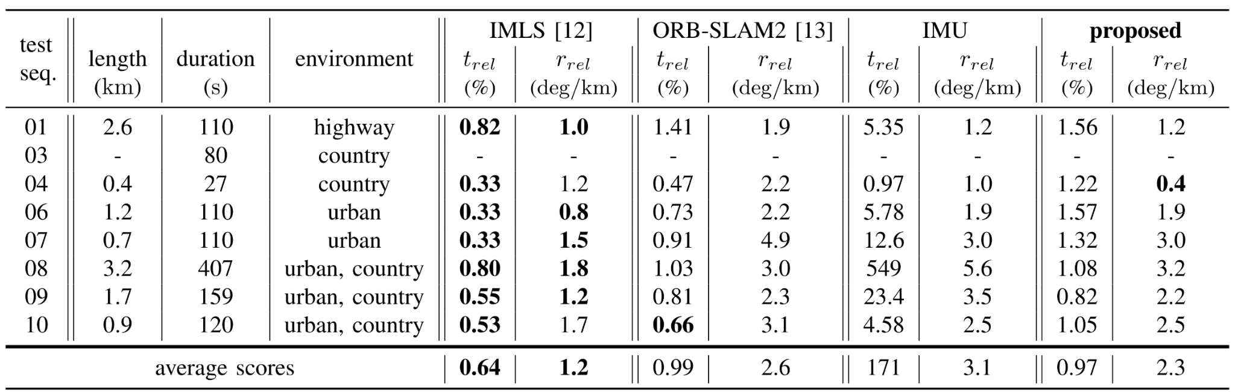
The Author’s Good Result
“We achieve on average a 1.10% translational error”
Notes:
We can see the filter perform pretty well,
Especially when we are moving in a straight line,
+ taken in to account the mis alignment of axis and translation vector as state in filter help to reduce the error from 2% to 1.1 %
+

Slide 12
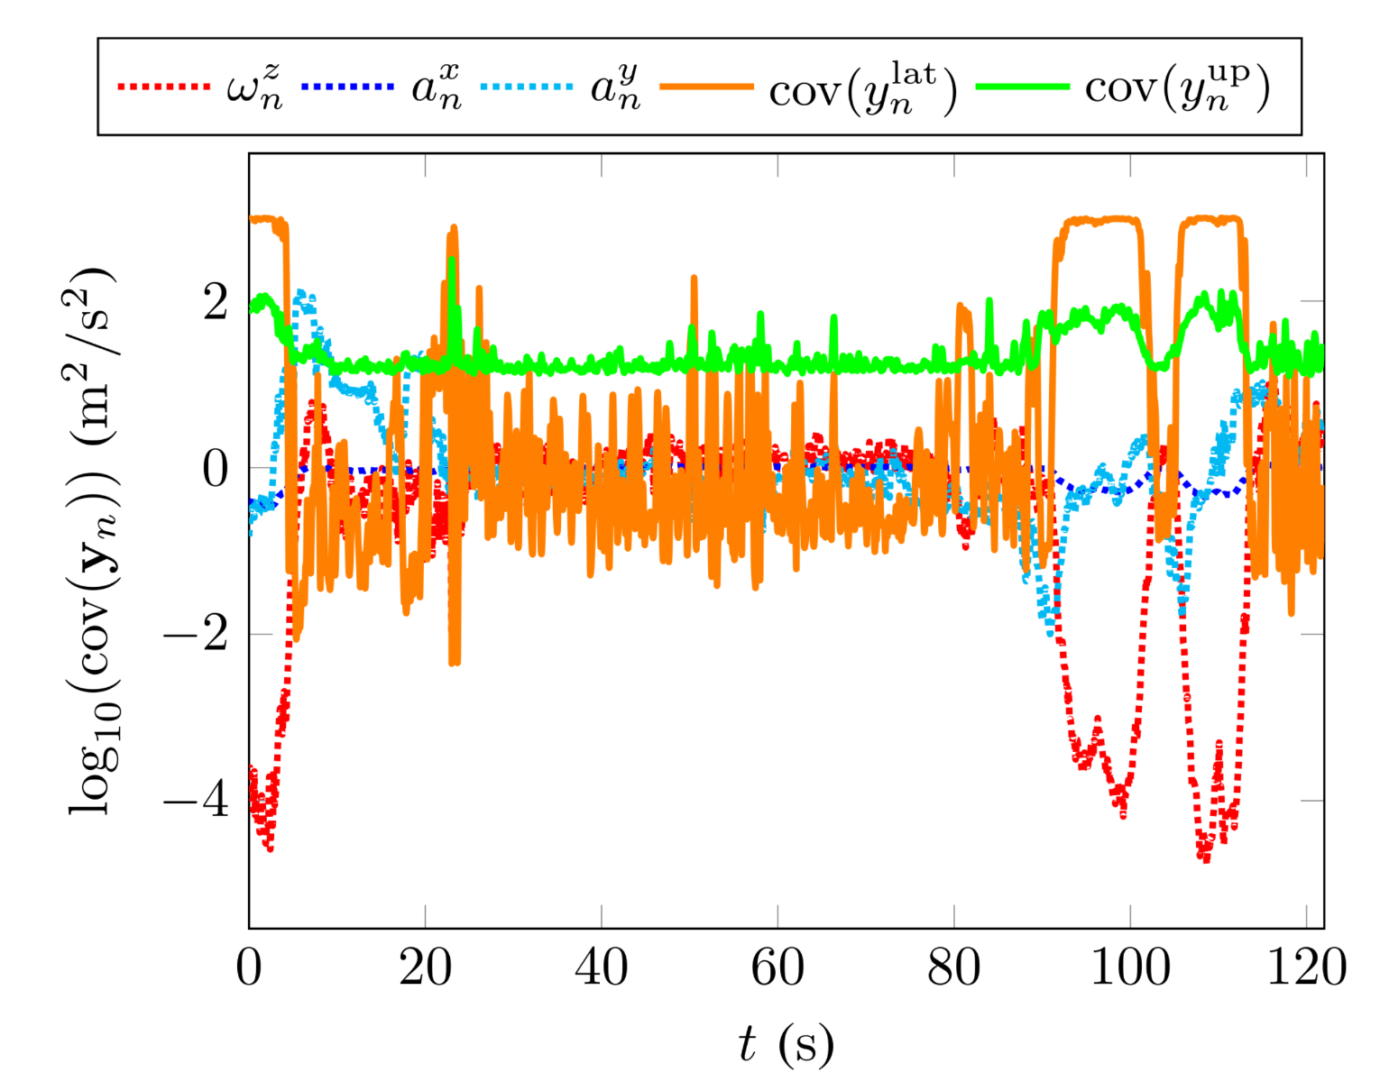
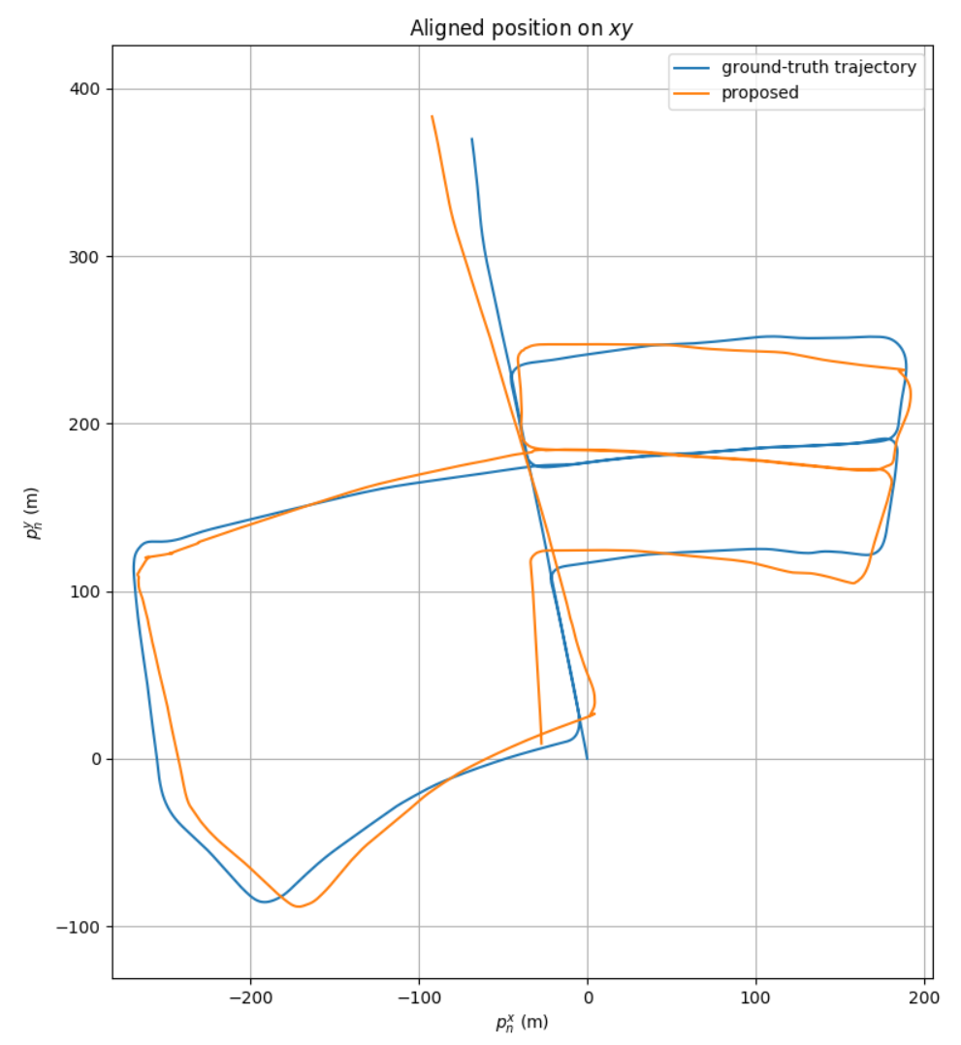
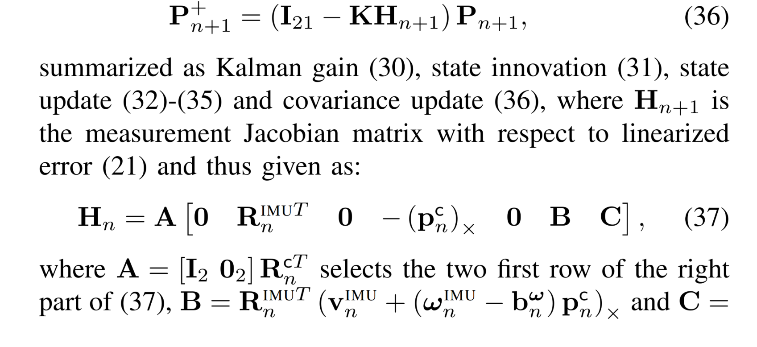
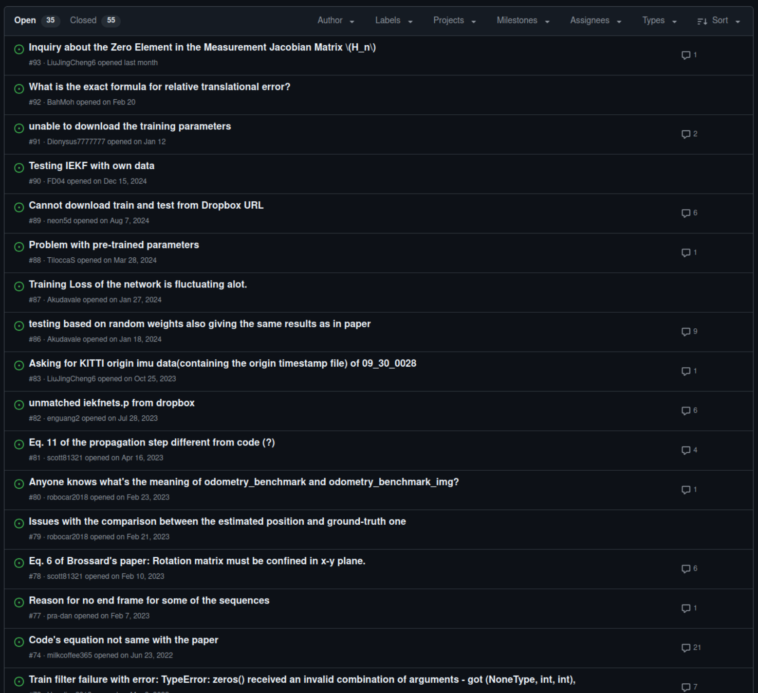
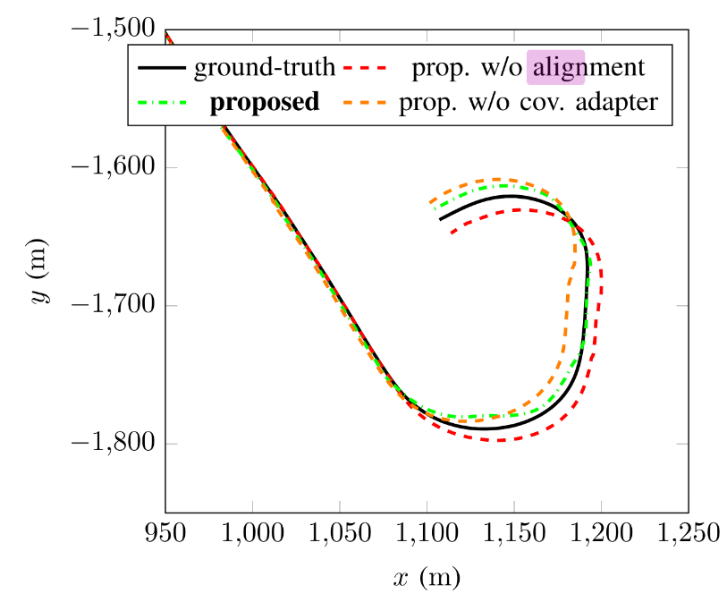
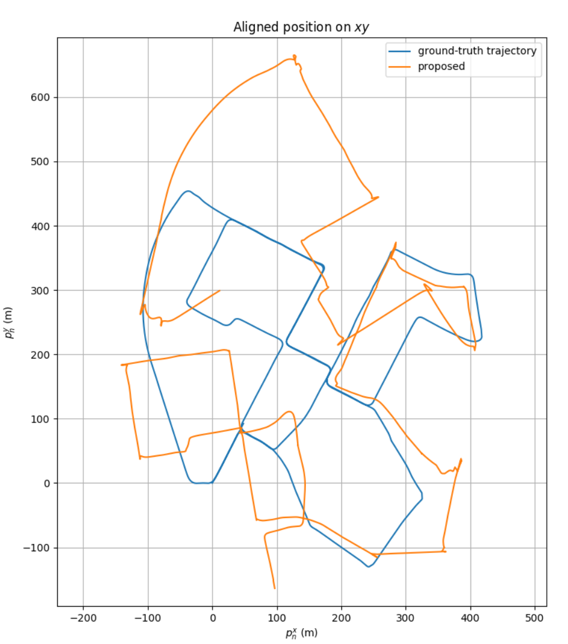
The Author’s Bad Result

Slide 13
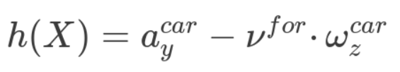
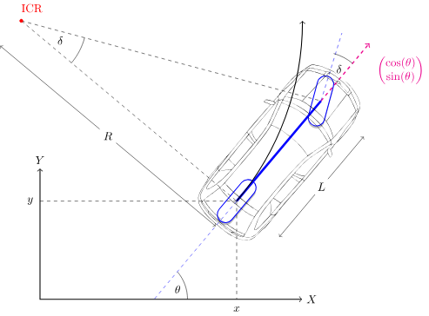
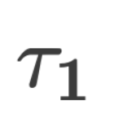
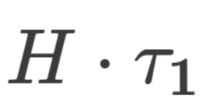
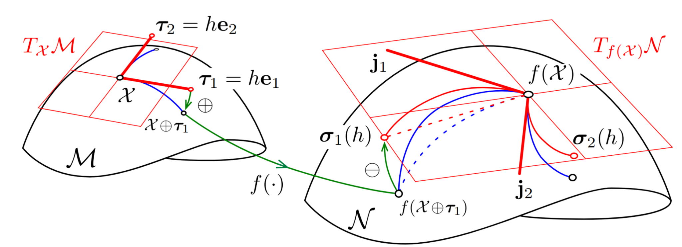
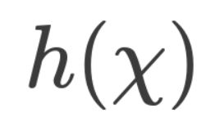
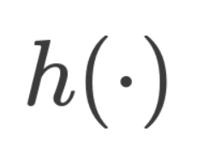
Our Approach
Account for centrifugal acceleration as New Pseudo-measurement
State
Measurement
Ackerman model

Slide 14
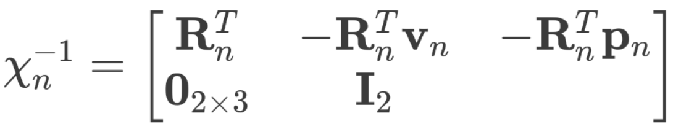
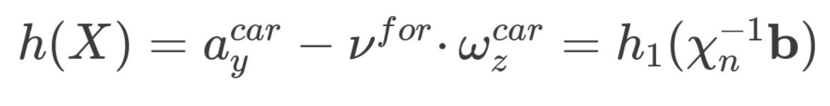
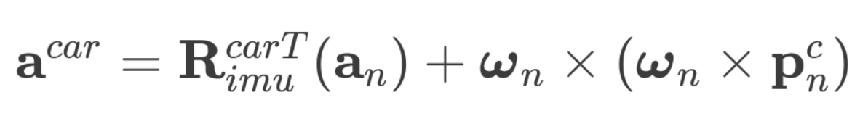
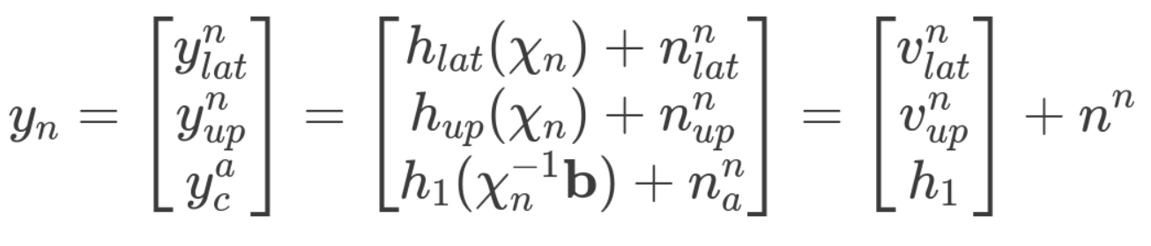
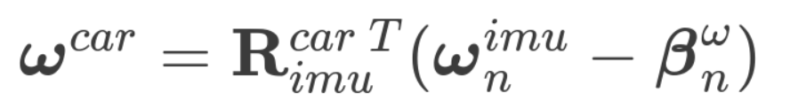

Our Approach
New Pseudo-Measurement model

Slide 15



Covariance prediction model
MesNet

Slide 16
Covariance prediction model
MesNet
Orig. prediction

Slide 17
Covariance prediction model
MesNet
Orig. prediction
Ours

Slide 18



Train result(low number of epochs 4/6000)

Slide 19

Comparison and analysis

Slide 20


Result analysis

Slide 21

Result analysis
Notes:
The default value

Slide 22
Limitations
Sensor Dependence: Relies heavily on specific sensor configurations.
Lost Function: Only translation error
Hard to find proper constraints as Pseudo-measurements for general problem
Future Directions
Continue to Train the whole dataset
Account for centrifugal acceleration in propagation step
Explore CNN Architectures: Investigate different models
Incorporate Angular Acceleration: Enhance accuracy in dynamic scenarios like drifting
Test with others dataset
Notes:
Limitations
Sensor Dependence: The current approach relies heavily on specific sensor configurations, which may limit its applicability across different systems or environments.
Lost Function: Only translation error
Future Directions
Exploring Different CNN Architectures: Investigating various Convolutional Neural Network (CNN) architectures to improve the model's performance and adaptability in different scenarios.
Incorporating Angular Acceleration: Accounting for the angular acceleration of vehicles, particularly in dynamic situations like drifting or car racing competitions, to enhance the accuracy and robustness of the system.

Slide 23


